Slide 1

Chapter 11 Part 1
Database Performance Tuning
and Query Optimization
The slides in this presentation have been adapted from slides provided with the textbook, Database Systems: Design, Implementation, and Management,
12E, Cornel and Morris, Copyright © 2017 Cengage Learning.

Slide 2
Learning Objectives
About the importance of indexes in query processing
About the types of decisions the query optimizer has to make
Some common practices used to write efficient SQL code
How to formulate queries and tune the DBMS for optimal performance
Copyright © 2017 Cengage Learning
2

Slide 3
Indexes and Query Optimization
Indexes
Essential for adequate speed of data access
Facilitate searching, sorting, and using aggregate functions as well as join operations
Ordered set of values that contains index key and pointers
More efficient to use index to access table than to scan all rows in table sequentially
Copyright © 2017 Cengage Learning
3

Slide 4
Indexes and Query Optimization (cont’d.)
Data sparsity: number of different values a column could possibly have
Indexes implemented using:
Hash indexes
B-tree indexes
Bitmap indexes
DBMSs determine best type of index to use
Copyright © 2017 Cengage Learning
4

Slide 5
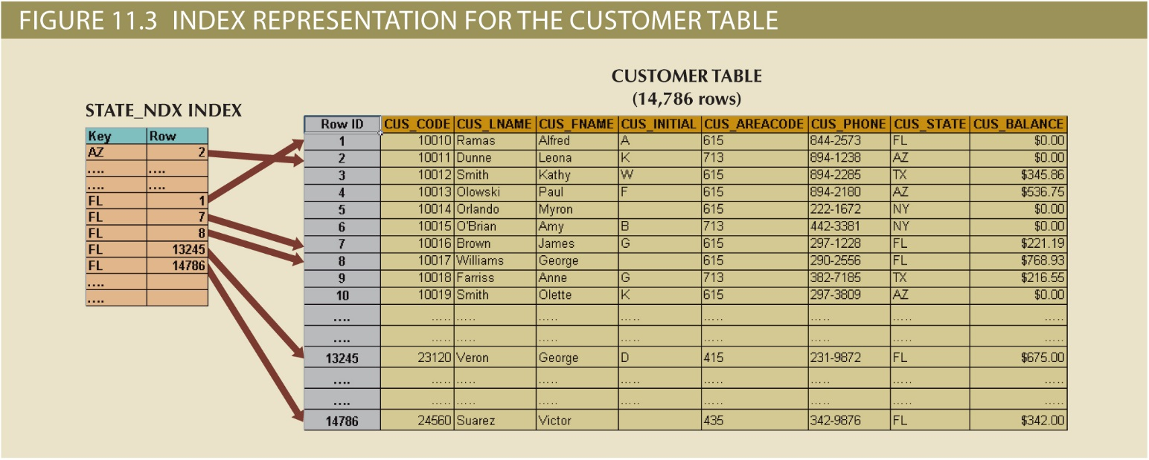
Copyright © 2017 Cengage Learning
5

Slide 6
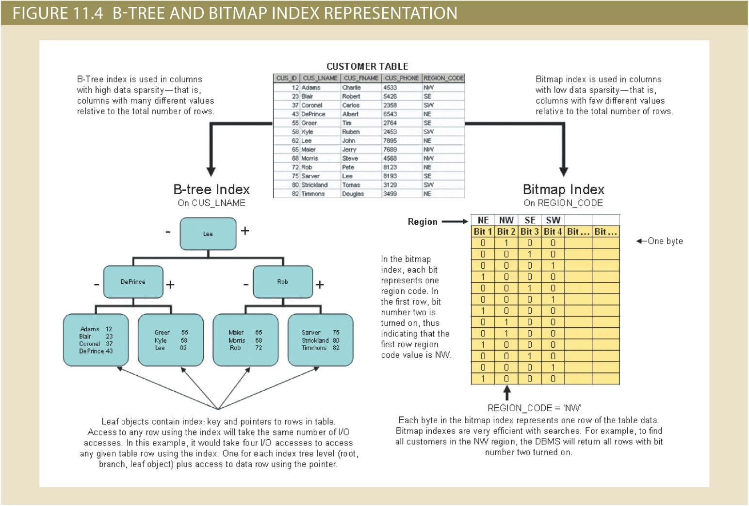
Copyright © 2017 Cengage Learning
6

Slide 7
Optimizer Choices
Rule-based optimizer
Preset rules and points
Rules assign a fixed cost to each operation
Cost-based optimizer
Algorithms based on statistics about objects being accessed
Adds up processing cost, I/O costs, resource costs to derive total cost
Copyright © 2017 Cengage Learning
7

Slide 8
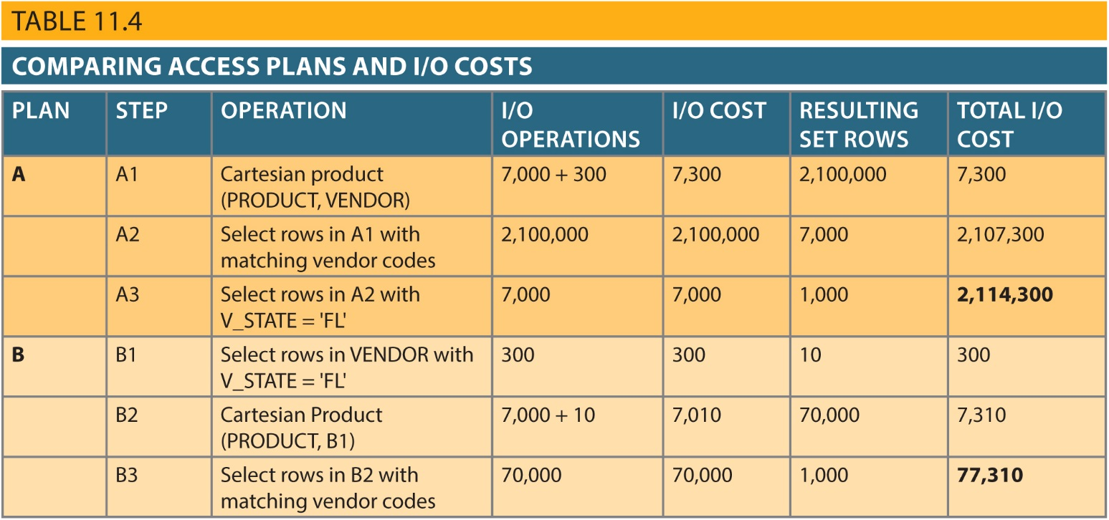
Comparing Access Plans
Copyright © 2017 Cengage Learning
8

Slide 9
Using Hints to Affect Optimizer Choices
Optimizer might not choose the best execution plan
Makes decisions based on existing statistics, which might be old
Might choose less-efficient decisions
Optimizer hints: Special instructions for the optimizer, embedded in the SQL command text
Copyright © 2017 Cengage Learning
9

Slide 10
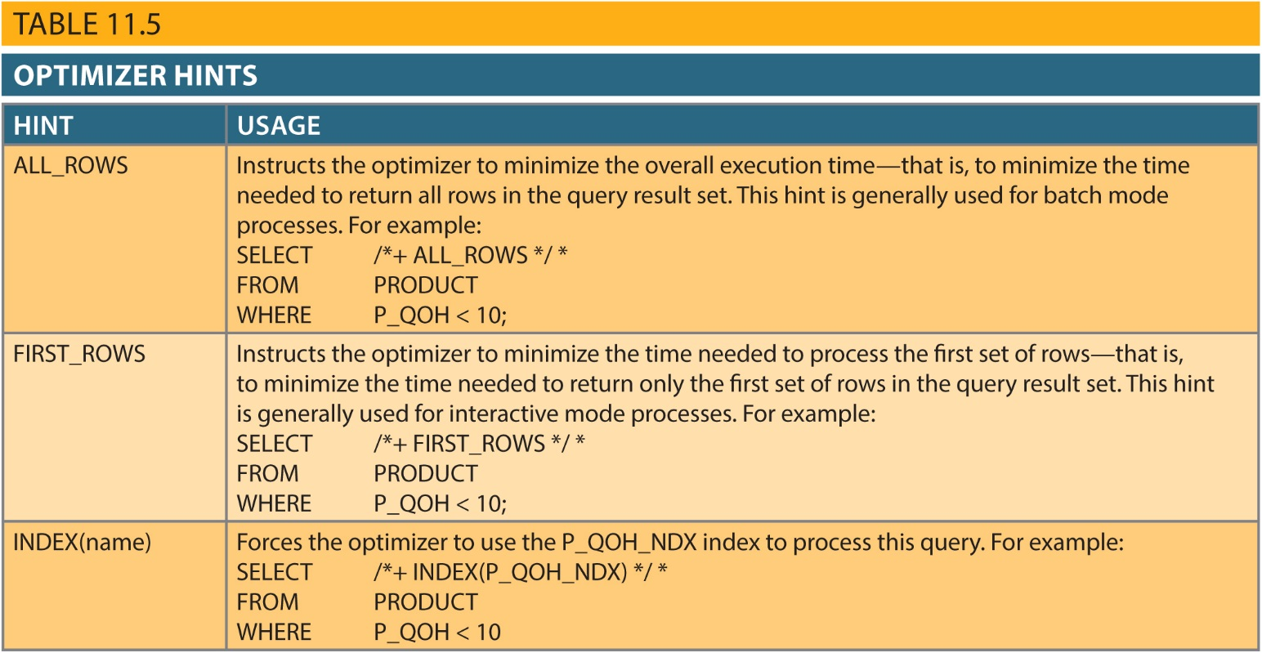
Table 11.5 - Optimizer Hints
Copyright © 2017 Cengage Learning
10

Slide 11
SQL Performance Tuning
Evaluated from client perspective
Most current relational DBMSs perform automatic query optimization at the server end
Most SQL performance optimization techniques are DBMS-specific and thus rarely portable
Majority of performance problems are related to poorly written SQL code
Copyright © 2017 Cengage Learning
11

Slide 12
Index Selectivity
Measure of how likely an index will be used
Index cannot always be used to improve performance
Indexes are used when:
Indexed column appears by itself in search criteria of WHERE or HAVING clause
Indexed column appears by itself in GROUP BY or ORDER BY clause
MAX or MIN function is applied to indexed column
Data sparsity on indexed column is high
When a subset of rows from a large table is to be selected based on a given condition
Copyright © 2017 Cengage Learning
12

Slide 13
Index Selectivity (cont’d.)
General guidelines for indexes:
Create indexes for each attribute in WHERE, HAVING, ORDER BY, or GROUP BY clause
Do not use in small tables or tables with low sparsity
Declare primary and foreign keys so optimizer can use indexes in join operations
Declare indexes in join columns other than PK/FK
Copyright © 2017 Cengage Learning
13

Slide 14
Conditional Expressions
Expressed within WHERE or HAVING clauses of a SQL statement
Restricts the output of a query to only rows matching conditional criteria
Guidelines to write efficient conditional expressions in SQL code
Use simple columns or literals as operands
Numeric field comparisons are faster than character, date, and NULL comparisons
Copyright © 2017 Cengage Learning
14

Slide 15
Conditional Expressions
Equality comparisons are faster than inequality comparisons
Transform conditional expressions to use literals
Write equality conditions first when using multiple conditional expressions
When using multiple AND conditions, write the condition most likely to be false first
When using multiple OR conditions, put the condition most likely to be true first
Avoid the use of NOT logical operator
Copyright © 2017 Cengage Learning
15

Slide 16
Query Formulation
Identify what columns and computations are required
Identify source tables
Determine how to join tables
Determine what selection criteria are needed
Determine the order in which to display the output
Copyright © 2017 Cengage Learning
16

Slide 17
DBMS Performance Tuning
Managing DBMS processes in primary memory and the structures in physical storage
DBMS performance tuning at server end focuses on setting parameters used for:
Data cache
SQL cache
Sort cache
Optimizer mode
In-memory database: Store large portions of the database in primary storage
Copyright © 2017 Cengage Learning
17

Slide 18
DBMS Performance Tuning
Recommendations for physical storage of databases:
Use RAID (Redundant Array of Independent Disks) to provide a balance between performance improvement and fault tolerance
Minimize disk contention
Put high-usage tables in their own table spaces
Assign separate data files in separate storage volumes for indexes, system, and high-usage tables
Copyright © 2017 Cengage Learning
18

Slide 19
DBMS Performance Tuning
Take advantage of the various table storage organizations in the database
Index-organized table or clustered index table: Stores the end-user data and the index data in consecutive locations in permanent storage
Partition tables based on usage
Use denormalized tables where necessary
Store computed and aggregate attributes in tables
Copyright © 2017 Cengage Learning
19

Slide 20
Query Optimization Example
Example illustrates how query optimizer works
Based on QOVENDOR and QOPRODUCT tables
Uses Oracle SQL*Plus
Copyright © 2017 Cengage Learning
20

Slide 21
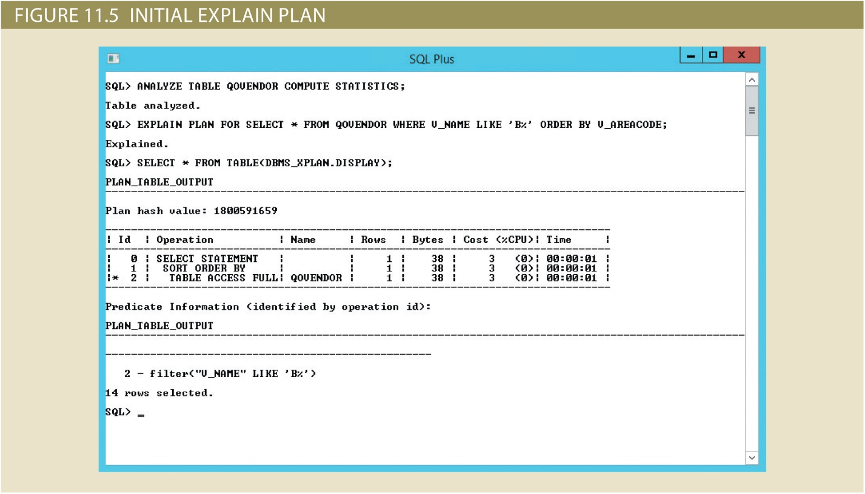
Copyright © 2017 Cengage Learning
21

Slide 22
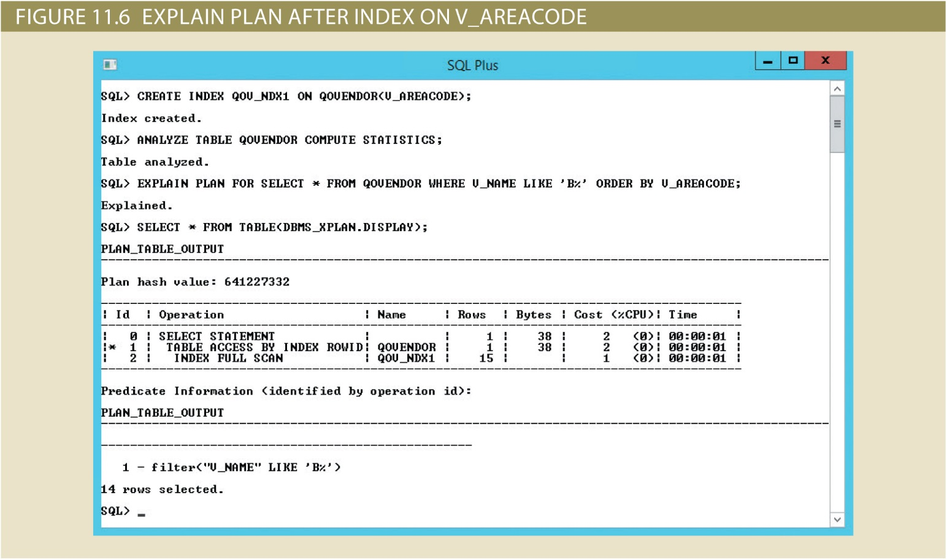
Copyright © 2017 Cengage Learning
22

Slide 23
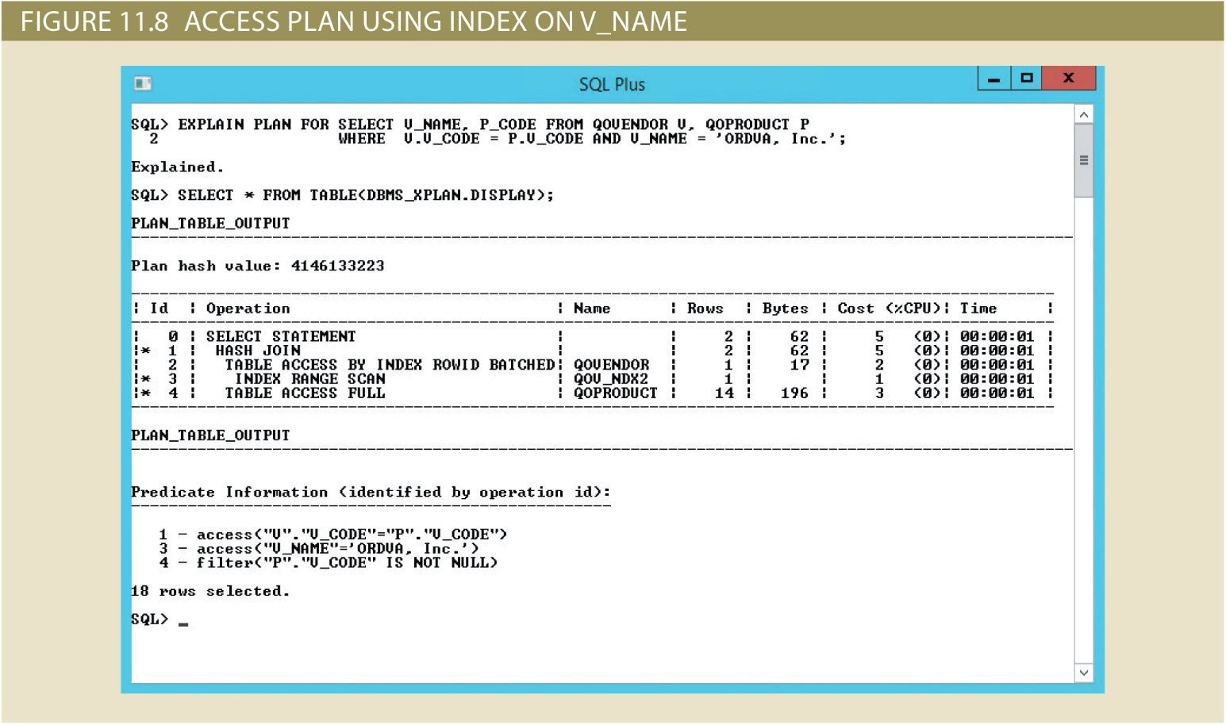
Copyright © 2017 Cengage Learning
23

Slide 24
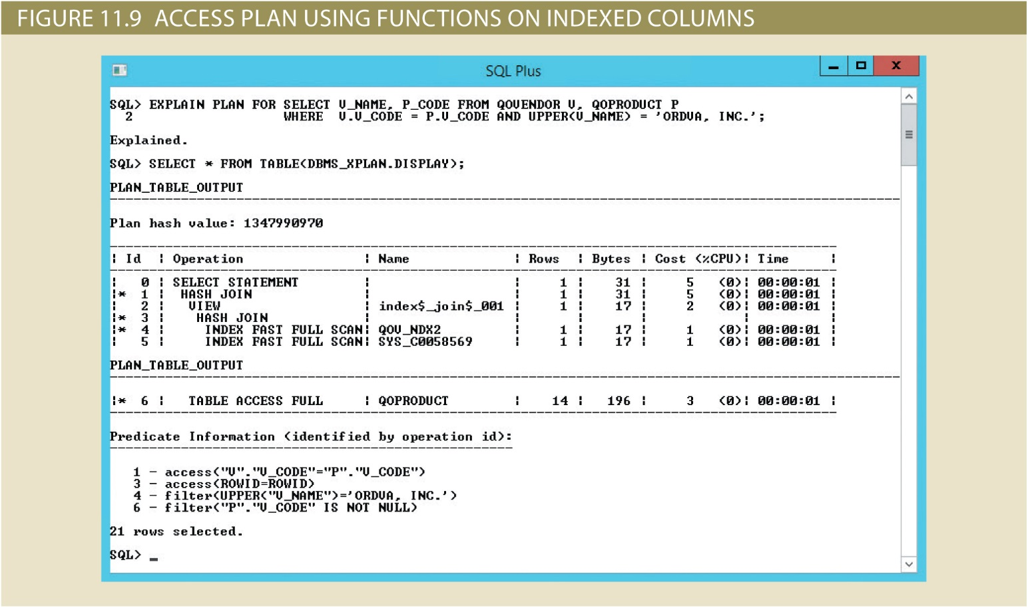
Copyright © 2017 Cengage Learning
24

Slide 25
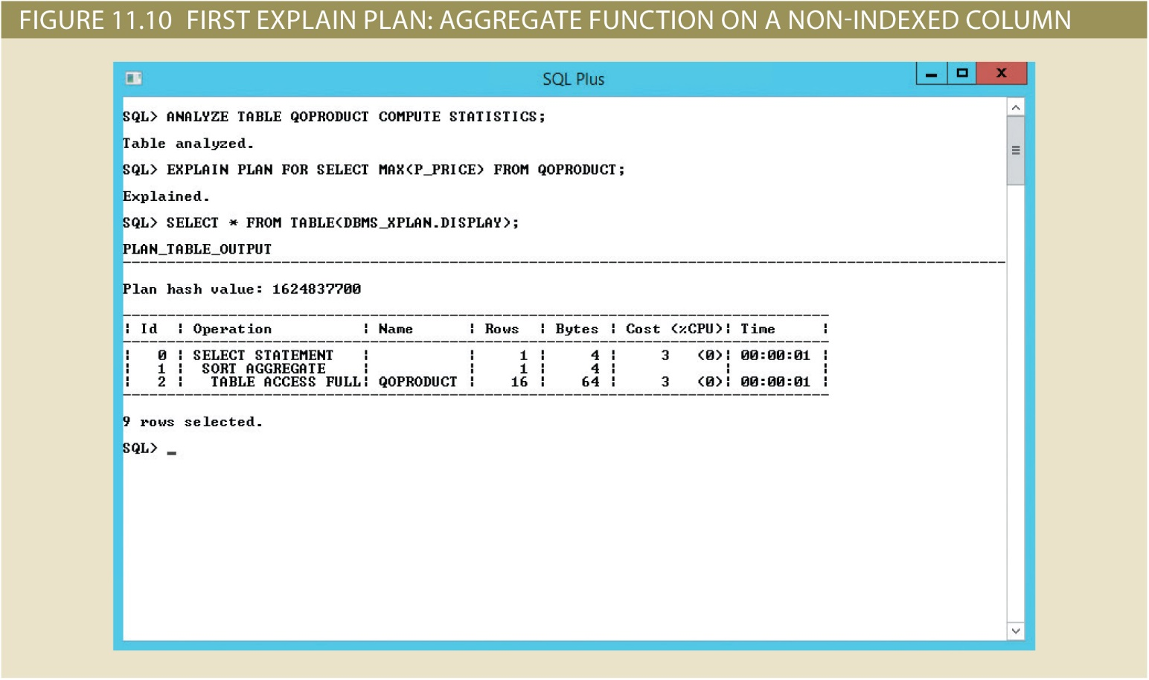
Copyright © 2017 Cengage Learning
25

Slide 26
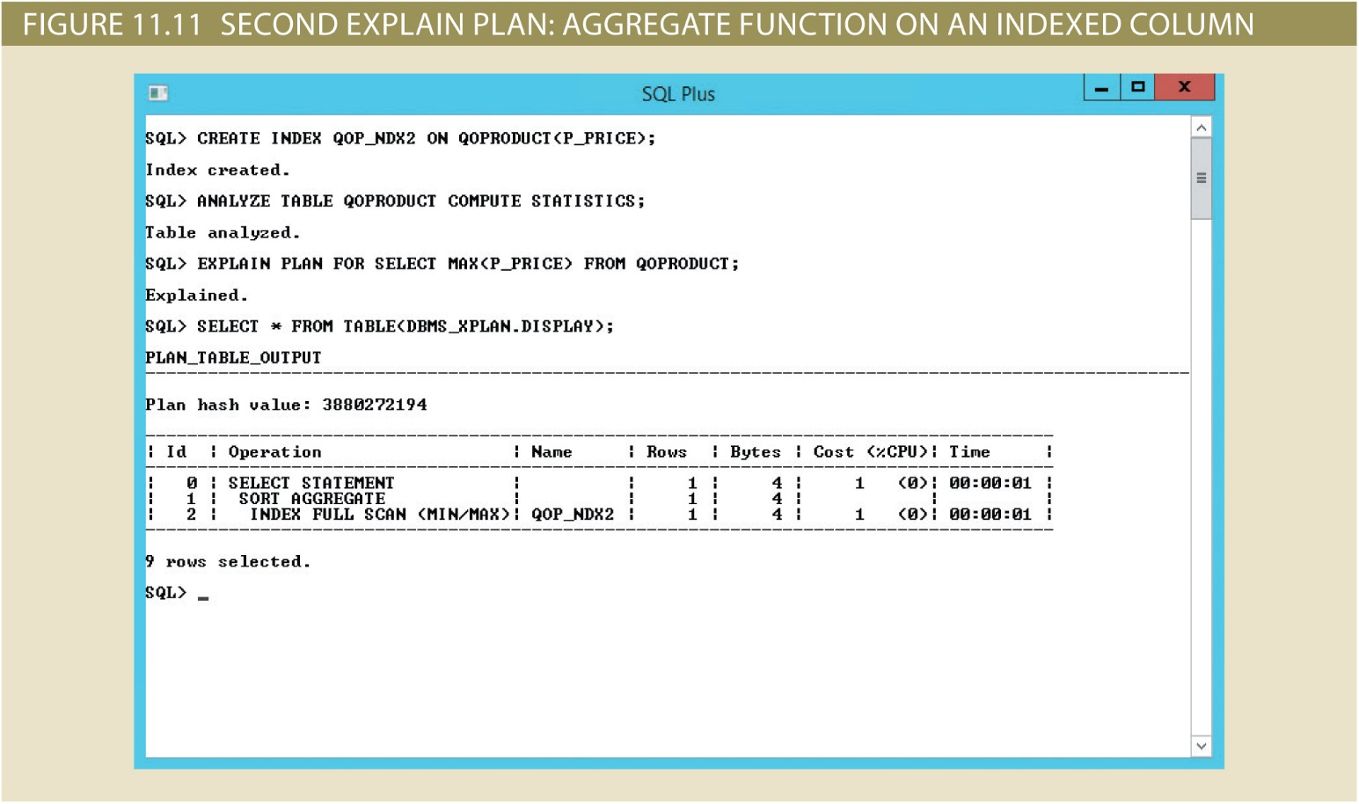
Copyright © 2017 Cengage Learning
26

Slide 27
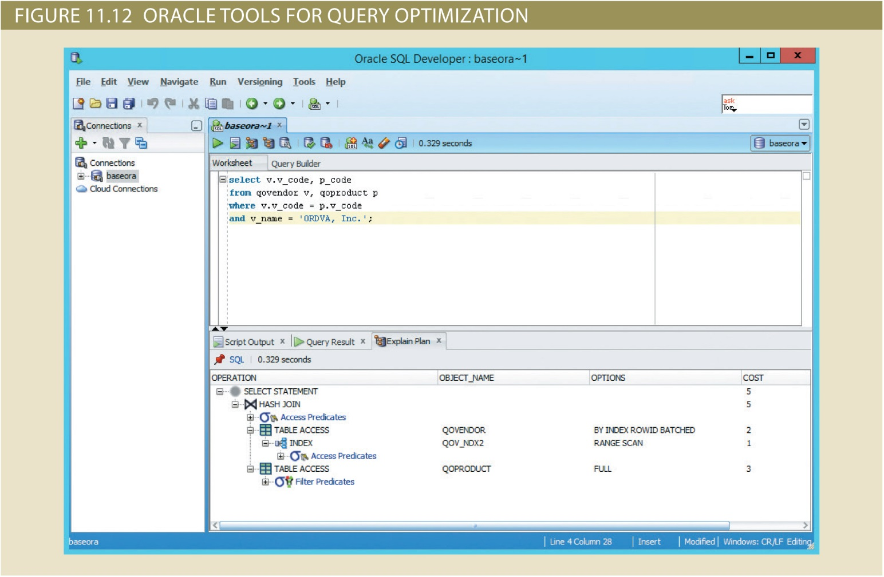
Copyright © 2017 Cengage Learning
27

Slide 28
Summary
Indexes are crucial in process that speeds up data access
During query optimization, DBMS chooses:
Indexes to use, how to perform join operations, table to use first, etc.
Hints change optimizer mode for current SQL statement
SQL performance tuning deals with writing queries that make good use of statistics
Query formulation deals with translating business questions into specific SQL code
Copyright © 2017 Cengage Learning
28

Slide 29
Task
Imagine a query plan for one of your reports from project 1.
Copyright © 2017 Cengage Learning
29

